Slide 1
We Make your World Easier

Slide 2
How to Read an Airman Parts Catalog

Slide 3
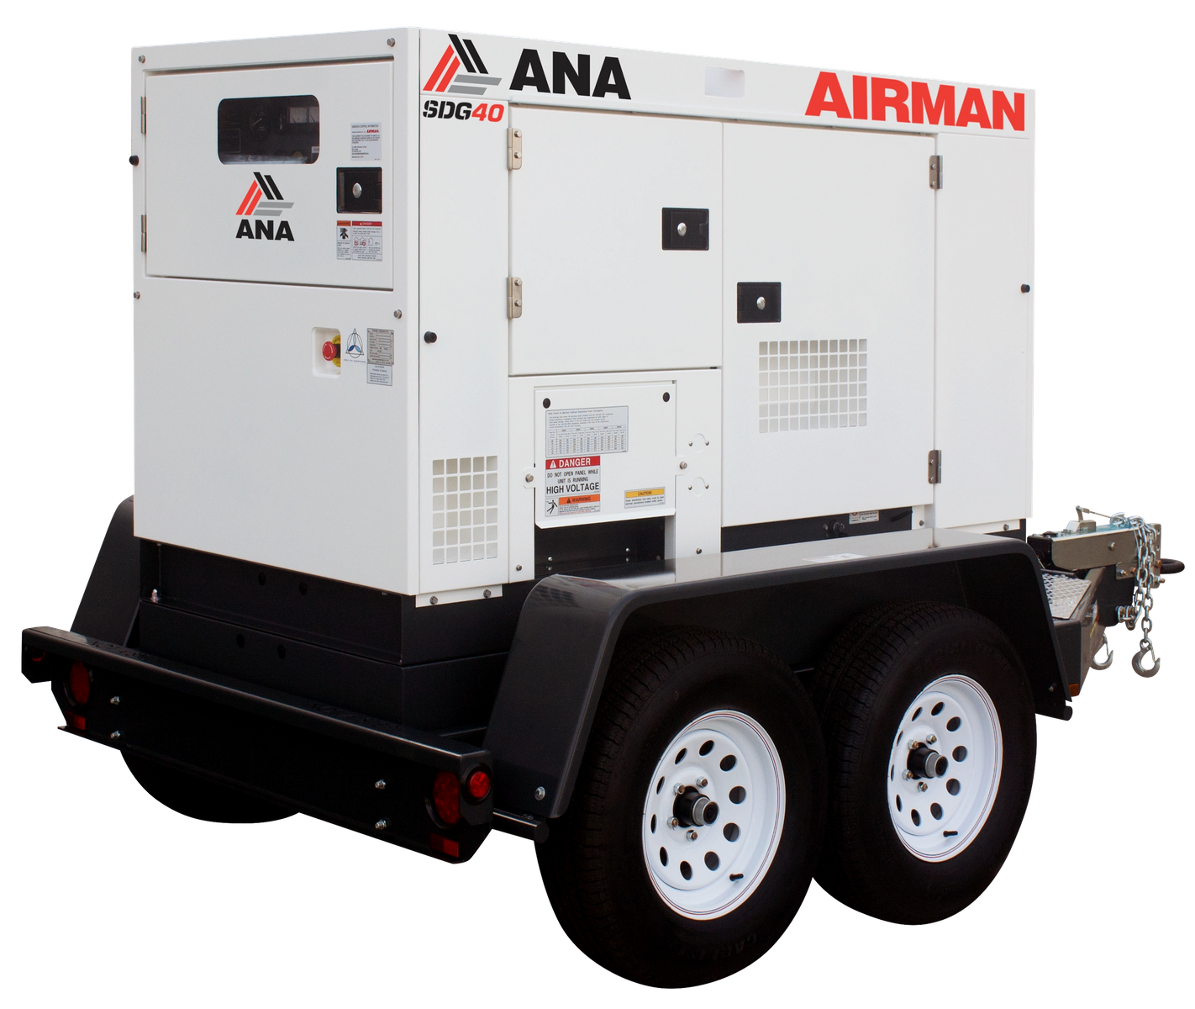
Notice:
This parts catalog contains all the parts and assemblies of “AIRMAN” brand products. The complete unit is divided into several parts groups, the details of which are clearly illustrated, and completely listed. So desired part number, name and quantity can be easily determined referring to the Reference Number.
Notes:
- What is the guiding principle?
- What are the key behaviors?

Slide 4
Placing Orders
When you place order for service parts, please be sure to advise us of the following information.
(1) Part number.
(2) Quantity required.
(3) Part name.
(4) Model name and Serial number.
For parts orders or quotes contact us at
(562) 450-3570 Ext. 2
Parts@anacorp.com
Notes:
- What is the guiding principle?
- What are the key behaviors?

Slide 5
abbreviations
Abbreviations that are used in Airman catalogs.
ass’y | assembly | L | Length
C/H | Change column | o & p | Overrun & parking brake
Comp. | Compressor | OPT. | Option
Const. | Consisting of | Press. | Pressure
Cont. | Control | SPC/S. | Special specifications
Cyl. | Cylinder | STD. | Standards
ENG. | Engine | T or t | Thickness
EXP. | Export | w. | with
Incl. | Including | w/o | without
Notes:
- What is the guiding principle?
- What are the key behaviors?

Slide 6
How to read parts catalog
Reading a parts catalog consists of (8) sections but not all the sections will be needed for each part.
All 8 sections will be explained.
Notes:
- What is the guiding principle?
- What are the key behaviors?

Slide 7
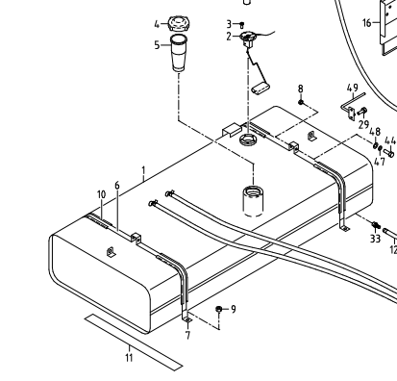
Reference number
(1) Ref. No.
Reference number (Ref. No.) is to be used for locating the part number and name from
the illustrations. (However, some parts such as bolts and nuts etc., are not
illustrated but their reference numbers only listed.)
Ref. No.1, 1-1, 1-2,…… shows history of part modifications.
[These reference numbers mean 1: primary period, 1-1: first alteration,
1-2: second alteration and 1-3……follows]
In this example we will be using an SDG25S-8E1 and looking for a fuel tank.
This fuel tank has two reference numbers that show the history of the part being modified.
In this example the part has been modified, there are two reference numbers showing 1 and 1-1.
If you do not have a dash, then that part has not been modified.
Notes:
- What is the guiding principle?
- What are the key behaviors?

Slide 8
Part number
(2) Part No.
Every part has its own proper number. Even if a part has the same shape as another part and if its number different, it is not interchangeable at all in many cases.
In this example we will be using an SDG25S-8E1 and looking for a fuel tank.
This part has two different part numbers because this part has been modified shown by the reference number.
The serial number of the unit will be needed to help identify which part number is correct.
Notes:
- What is the guiding principle?
- What are the key behaviors?

Slide 9
interchangeability
(3) Interchangeability
A, B, C, D, E, Q, X, Y and Z in column “Interchangeability” show the following.
A: A new part can replace an old part, but an old part cannot replace a new part.
B : Not interchangeable.
C : Disused.
D : Newly added.
E : Compatible with each other.
Q : Quantity per unit changed.
X : Included in this set of parts, this part is not used for this model.
Y : Part to be selected.
Z : This part can not be supplied as an individual part.
In this example we will be using an SDG25S-8E1 and looking for a fuel tank.
Using the interchangeability chart, we can tell that this fuel tank with the reference number 1-1 is not interchangeable with the fuel tank with the reference number 1. Therefore, each fuel tank (1 & 1-1) is specific to the serial number specified.
Notes:
- What is the guiding principle?
- What are the key behaviors?

Slide 10
Part name
(4) Part name
Every part has its own proper name.
In this example we will be using an SDG25S-8E1 and looking for a fuel tank.
The part number in this example would be “Fuel Tank”, this is useful when trying to order the part.
Notice that the part number and reference number change but the part name does not change.
Notes:
- What is the guiding principle?
- What are the key behaviors?

Slide 11
quantity
(5) Q’ty
The number shown in the column of Q'TY indicates the quantity of parts used per one unit machine.
In this example we will be using an SDG25S-8E1 and looking for a fuel tank.
The Quantity shows how many of that part number are used on this unit.
In this example this unit only uses one of these fuel tanks.
On parts like hoses, bolts, washers, clamps, etc. the quantity may be higher, so keep an eye out for how many needed when ordering.
Notes:
- What is the guiding principle?
- What are the key behaviors?

Slide 12
Applicable serial number
(6) Applicable Ser. No. (Serial Number)
Ser. No. shows the machine number to which the part is applicable. Month and year stated in column “Ser. No.” show the month and year from which the part is applicable.
In this example we will be using an SDG25S-8E1 and looking for a fuel tank.
For this example, we will use the serial number 1238E12629.
In this case the last four numbers of the serial number are 2629 this would fall under the 1-1 fuel tank based on the serial number of the unit.
If the ~ is before the numbers, then that means all the previous serial numbers are included.
If the ~ is after the numbers, then that means all the serials numbers after are included.
Notes:
- What is the guiding principle?
- What are the key behaviors?

Slide 13
Change column
(7) Change column
M1, M2,…… Mn mentioned in the column indicate the change of part number and the serial number of the unit, the part of which was modified.
In this example we will be using an SDG25S-8E1 and looking for a fuel tank.
The change column is used to detect serial breaks to specify any parts that were modified
Change column identifiers will always start with M. Our example here shows the identifier as M591.
At the top of the manual there is a list of machine serial numbers & changed part numbers all identified starting with M.
Notes:
- What is the guiding principle?
- What are the key behaviors?

Slide 14
remarks
(8) Remarks
This column “Remarks” mentions in mark or signal the specifications of each part, original part number of manufacturer, model name of the part for which is used etc.
[Example. SC: w. AFTER COOLER]
The remarks section is where you can find additional information regarding that specific part number.
These can be anything from letting you know that it includes and additional part numbers, it’s the forward/ reverse version, includes gaskets, strainers.
These can also give you the engine manufacturer’s part number.
Notes:
- What is the guiding principle?
- What are the key behaviors?

Slide 15
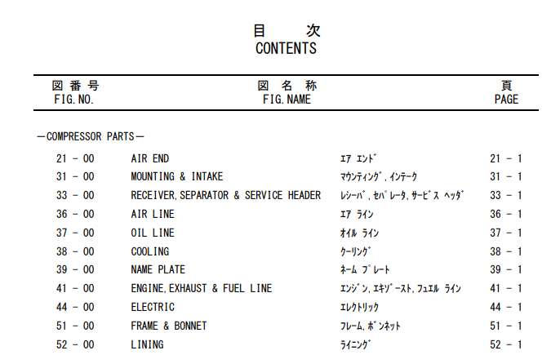
contents
Using the Contents page is a great quick reference to get you in the right area to find what you are looking for.
Notes:
- What is the guiding principle?
- What are the key behaviors?

Slide 16
Questions?

