Slide 1

ENTER TEXT HERE
Where are my Keys?

Slide 2
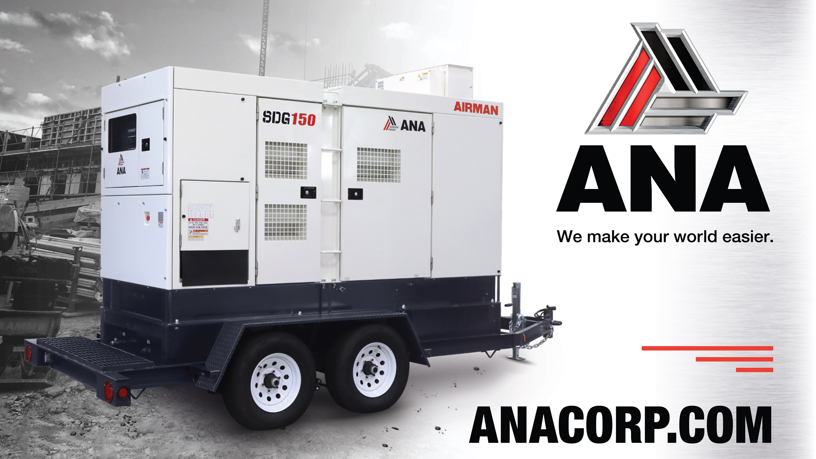
Support
(562) 450-3570 x3
ENTER TEXT HERE
THANK YOU VERY MUCH!

Slide 3

Agenda
Energy Boss Initial Key
Energy Boss Power Key

Slide 4
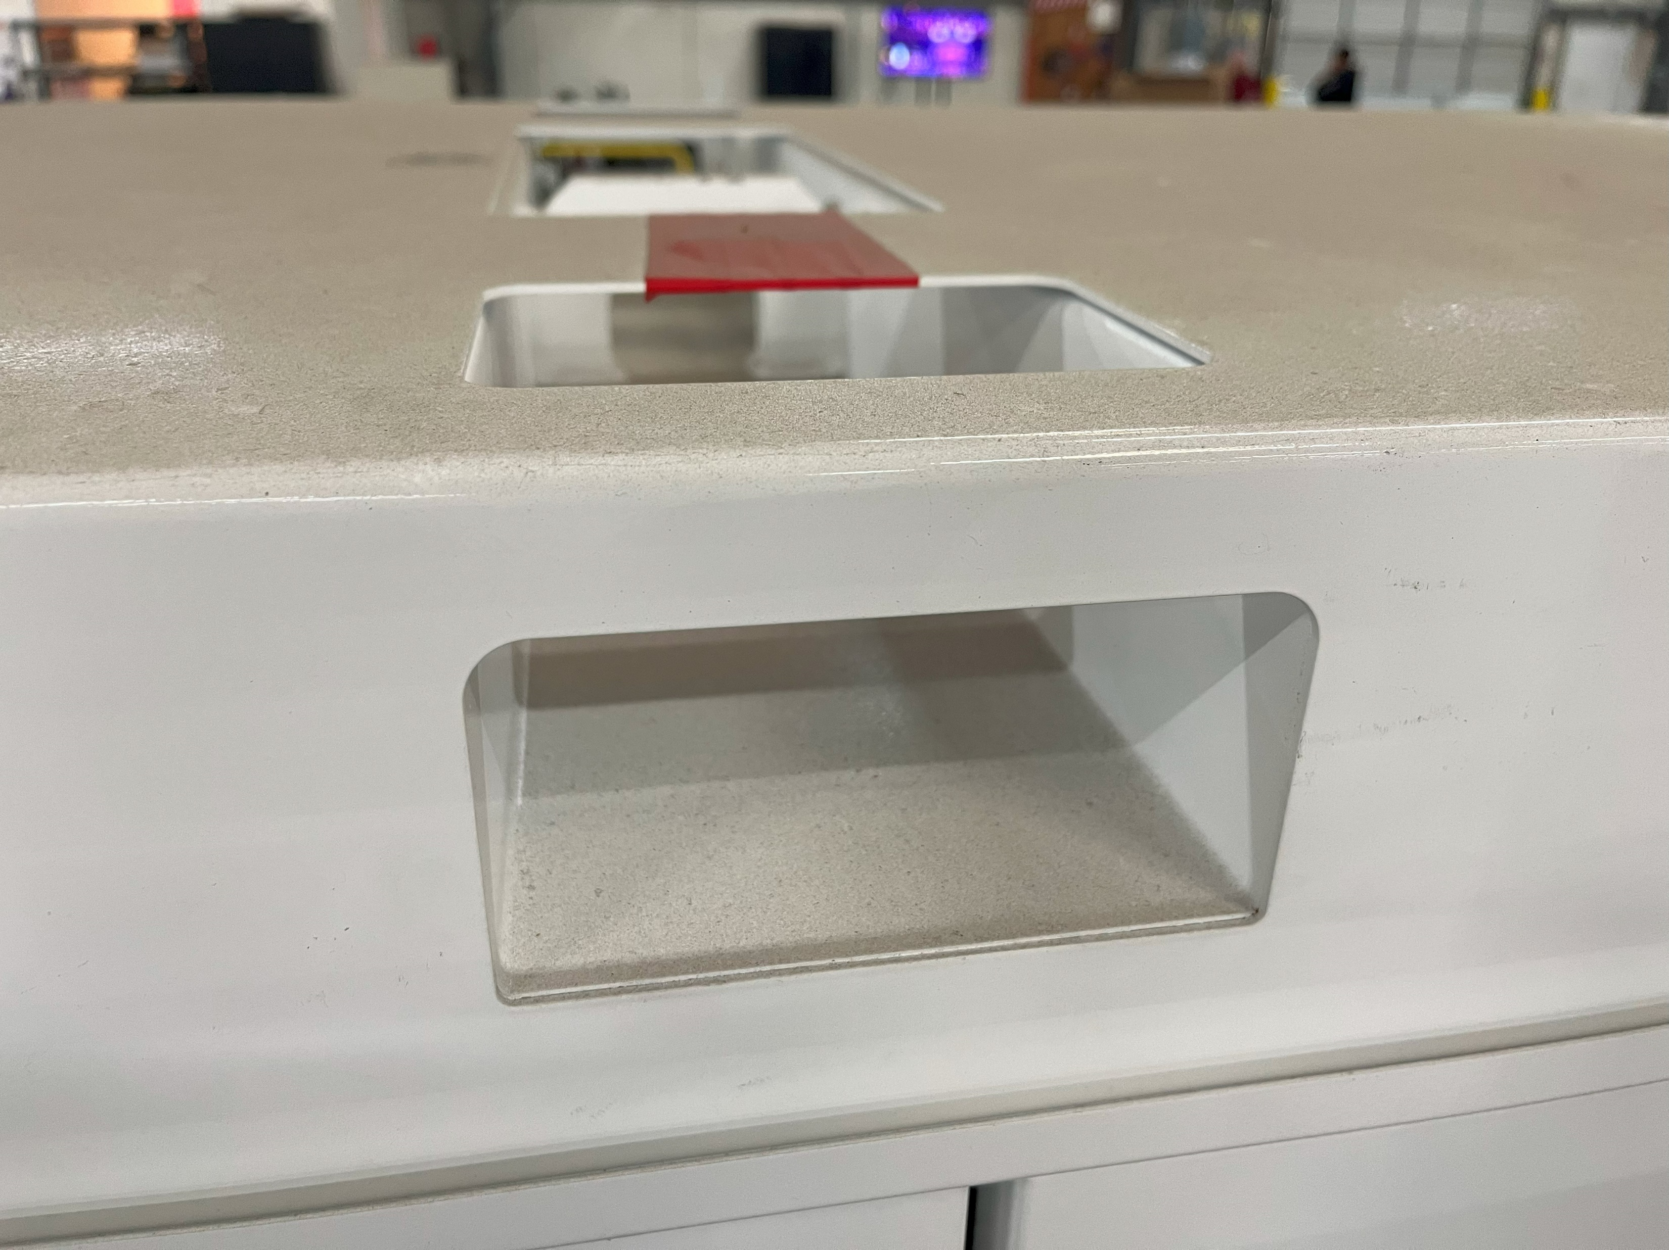
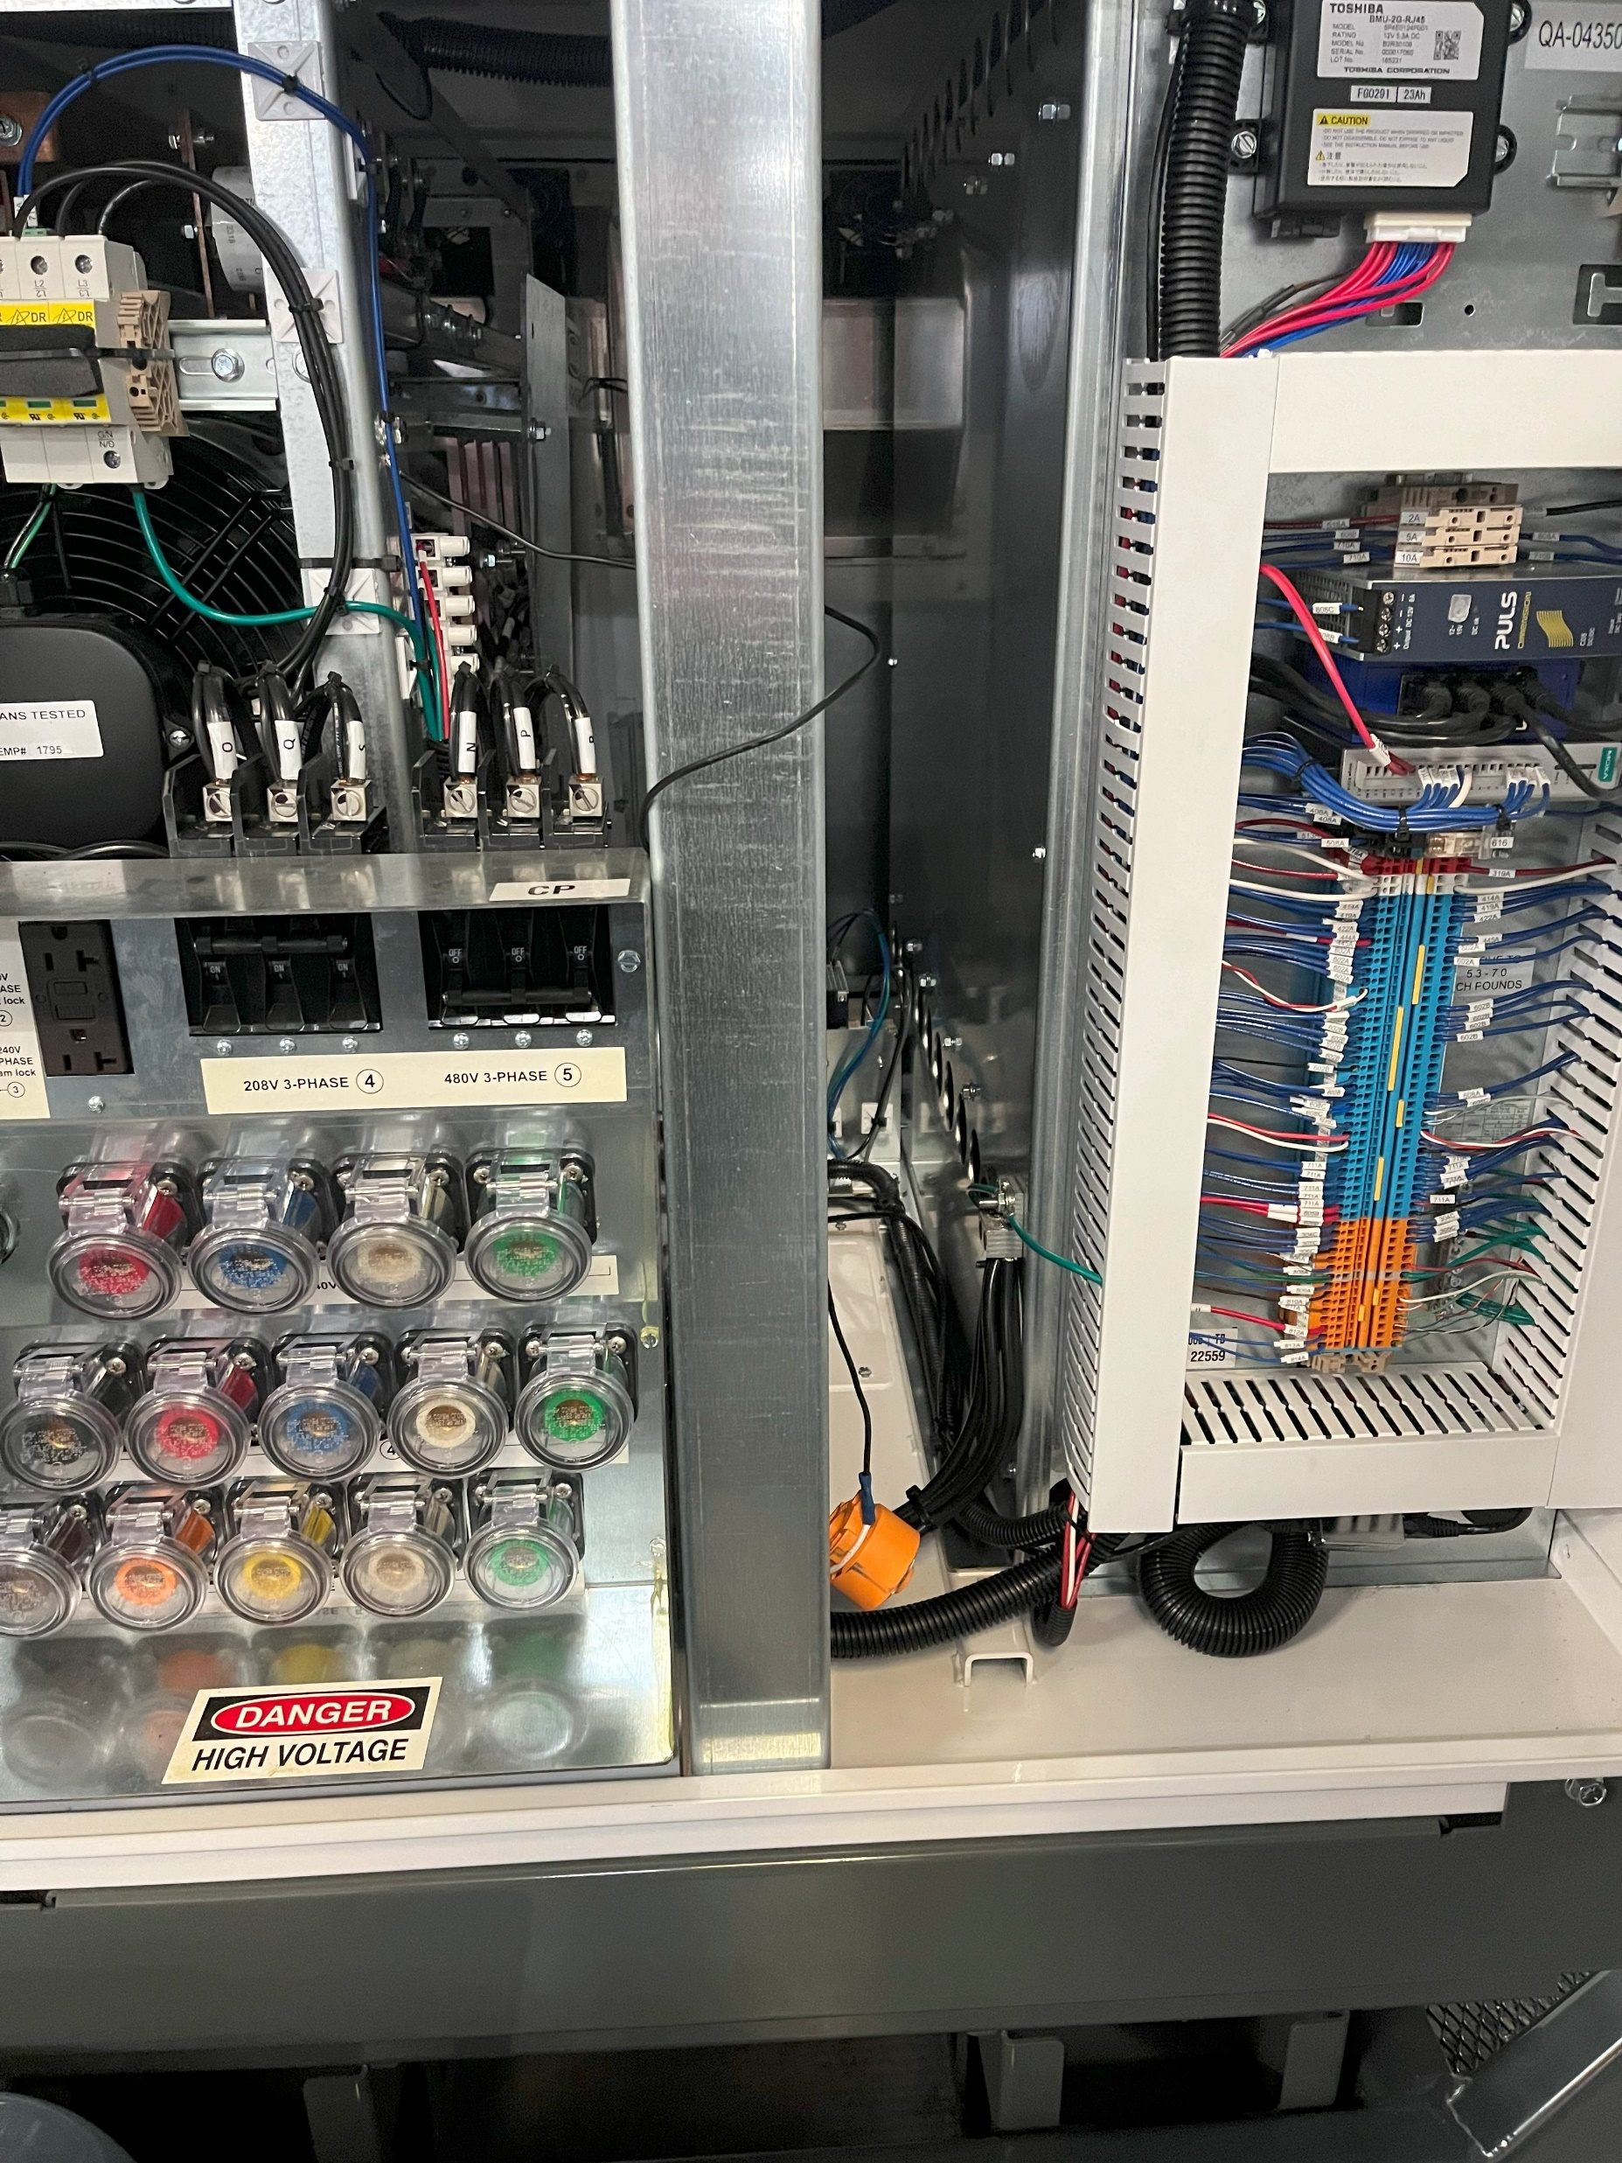
Notice:
Your new unit from ANA will have a separate key, under red tape, there will be an example for this unit. When this key is used it will give access to the sets of keys in your unit's manual compartment. There is also a power key that needs to be installed when the unit is in use.
Initial Key
Power Key

Slide 5


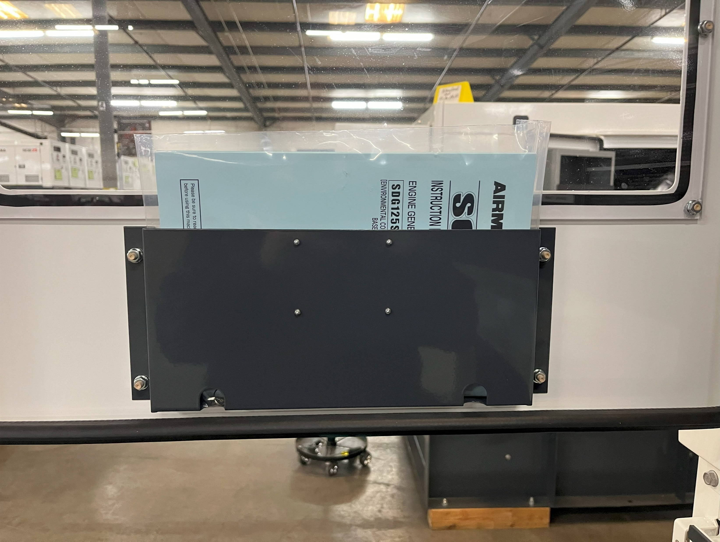
Manual Compartment with Key Sets
Initial Key
Energy Boss
Initial Key
On our Energy Boss the initial key will be on the top under red tape, there will be an example. The manual compartment will be located inside the door that gives access to the control panel.

Slide 6
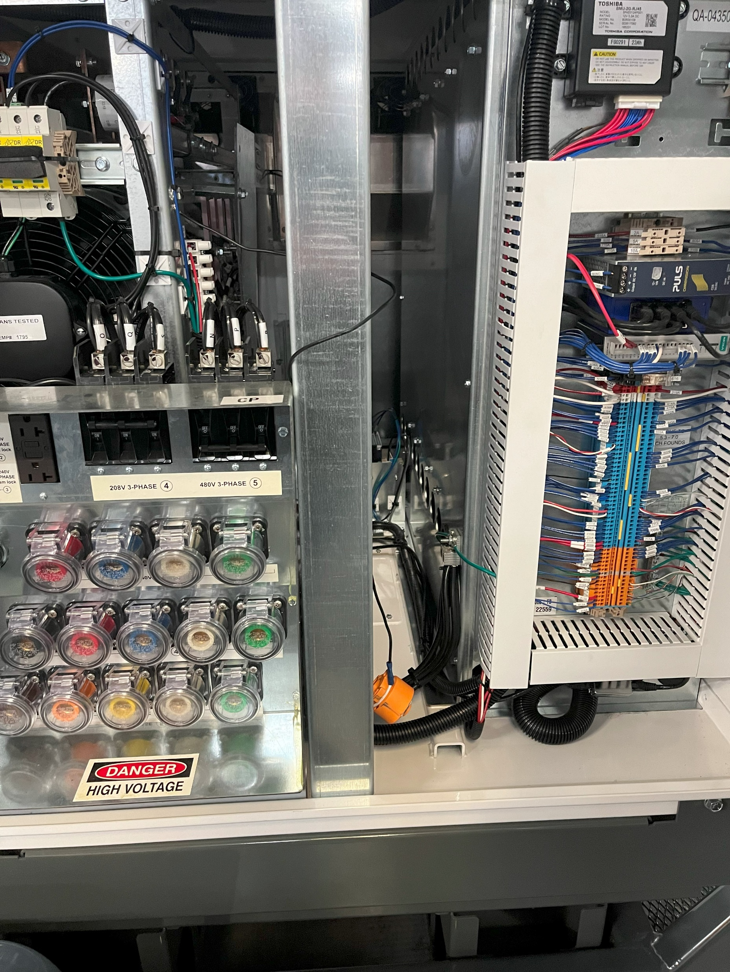
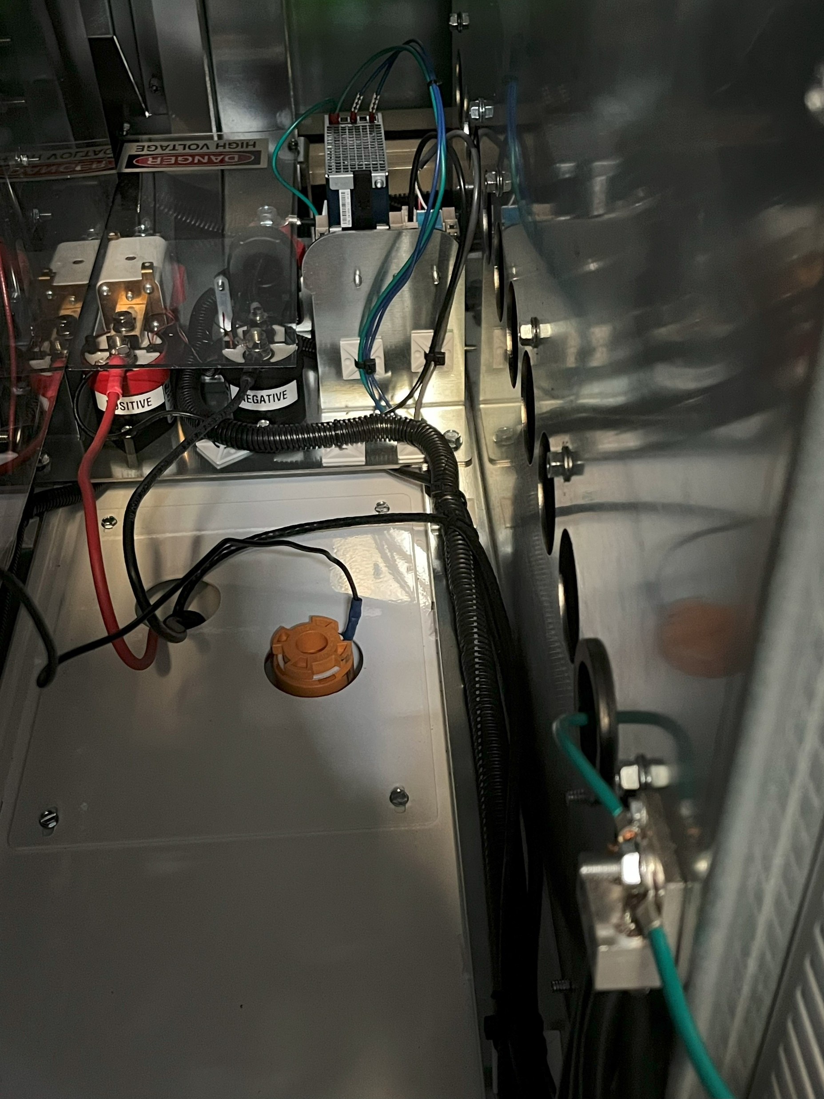
Power Key
Power Key with Connection Point
Energy Boss
Power Key
Our Energy Boss has a power key and a power key connection point. This key needs to be connected before using this unit. You will need a security torx (T-30) bit to gain access.

Slide 7
ENTER TEXT HERE
THANK YOU VERY MUCH!
(562) 450-3570 • ANACORP.COM • sales@anacorp.com

