Slide 1

ENTER TEXT HERE
Where is my Key?

Slide 2
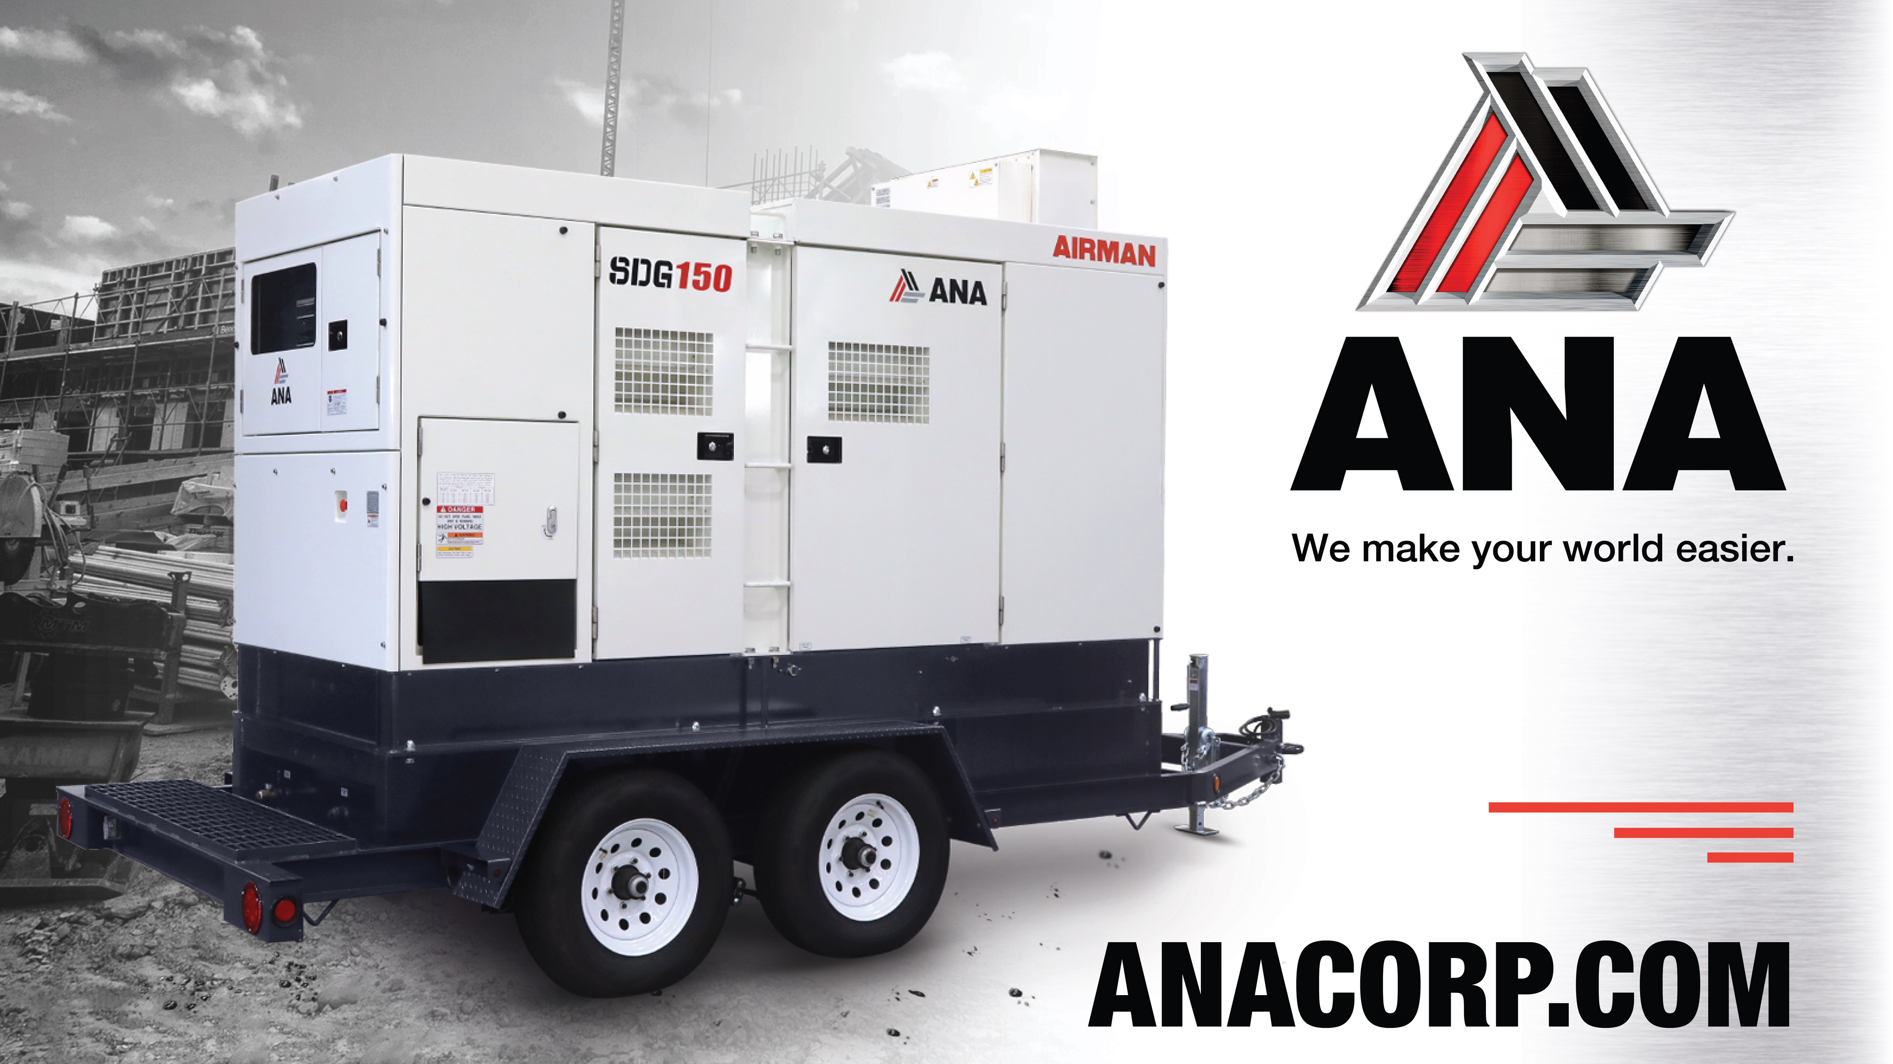
Support
(562) 450-3570 x3
ENTER TEXT HERE
THANK YOU VERY MUCH!

Slide 3

Agenda
Generators Keys
Compressors Keys

Slide 4
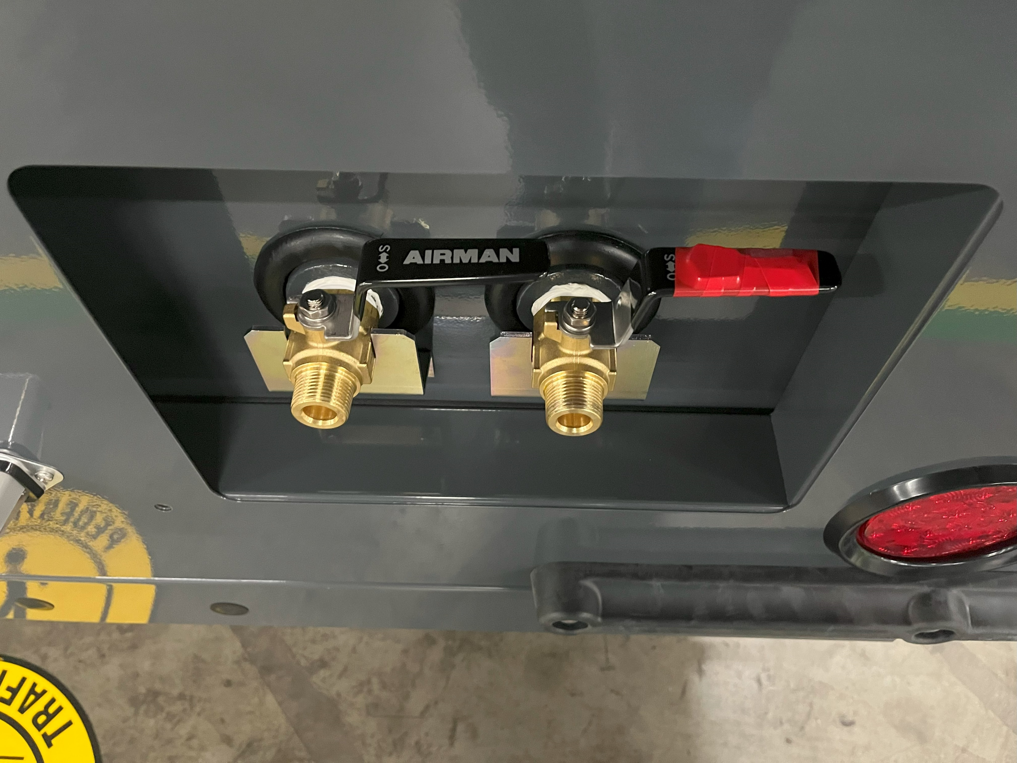
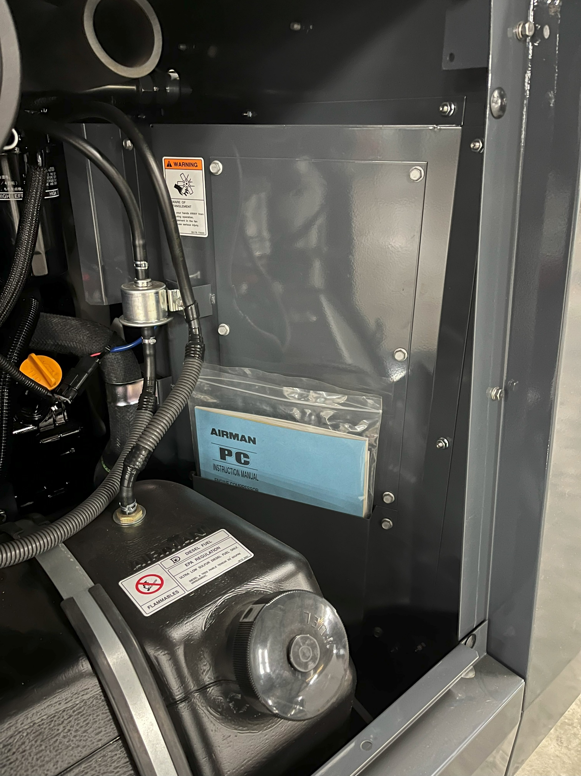
Notice:
Your new unit from ANA will have a separate key, under red tape, there will be examples for each unit and sizes. When this key is used it will give access to the sets of keys in your unit's manual compartment.

Slide 5

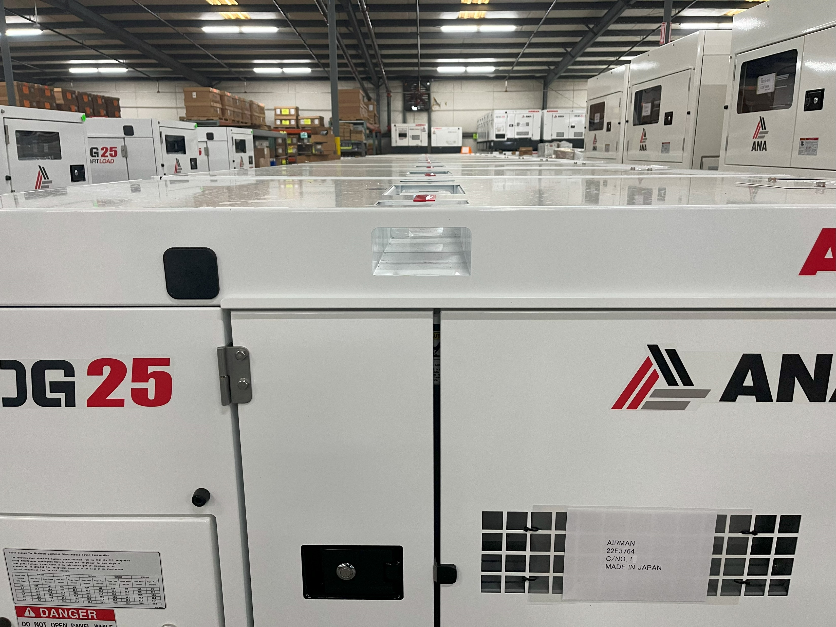
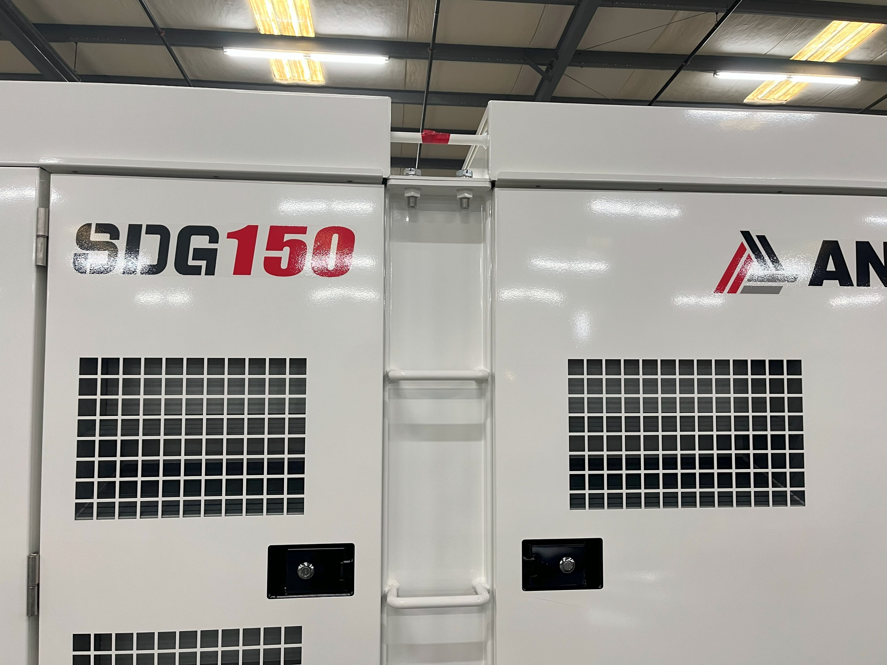
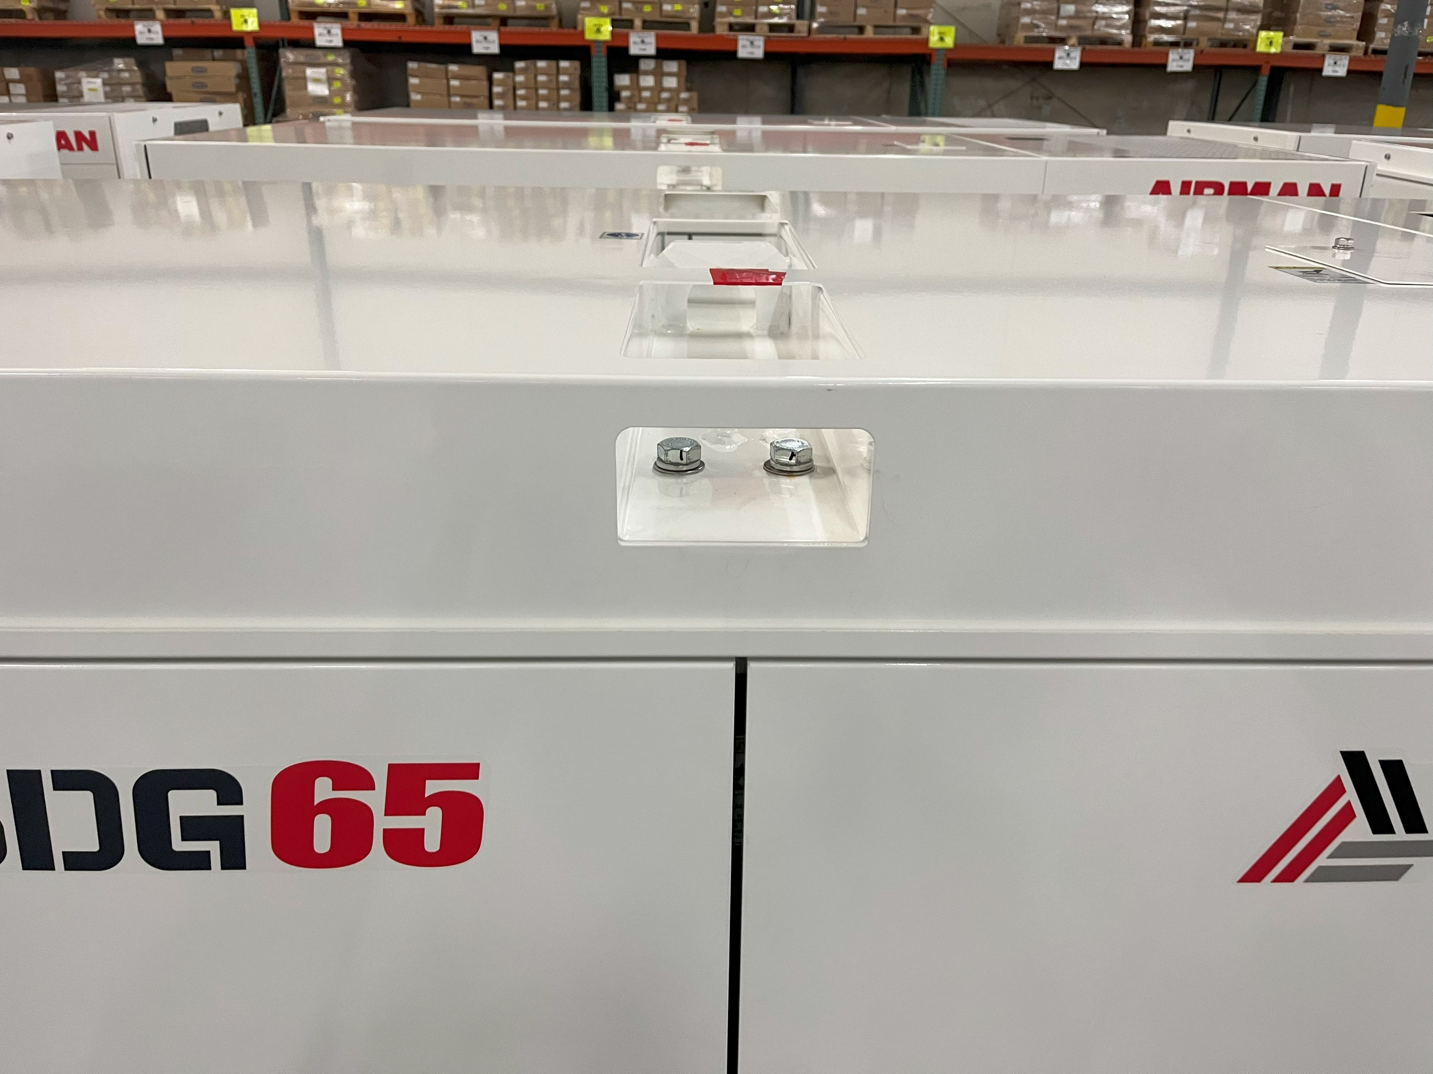
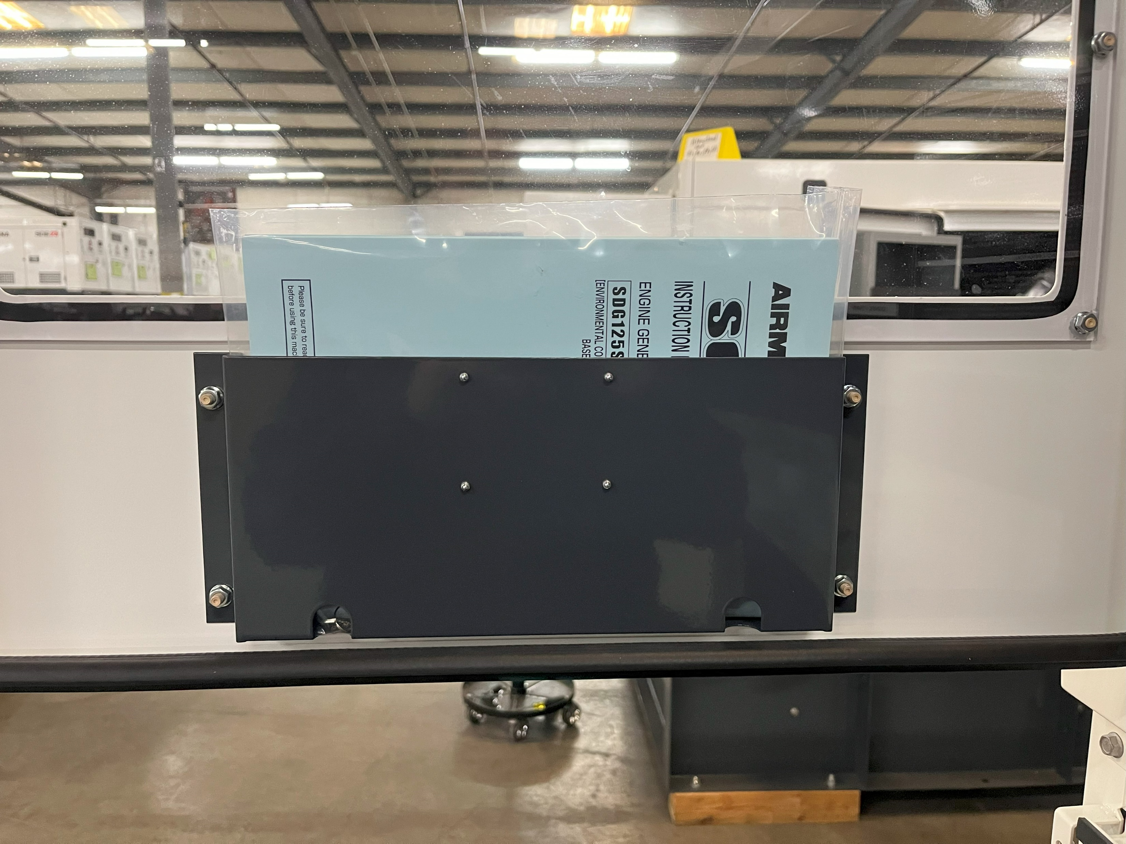
SDG25 Initial Key
SDG150 Initial Key
Generators
Key locations
On our generators the red tape location is always on top of the unit. There will be examples for different size generators. The manual compartment will be located inside the door that gives access to the control panel.
Manual Compartment with Key Sets
Inside Door
SDG65 Initial Key

Slide 6

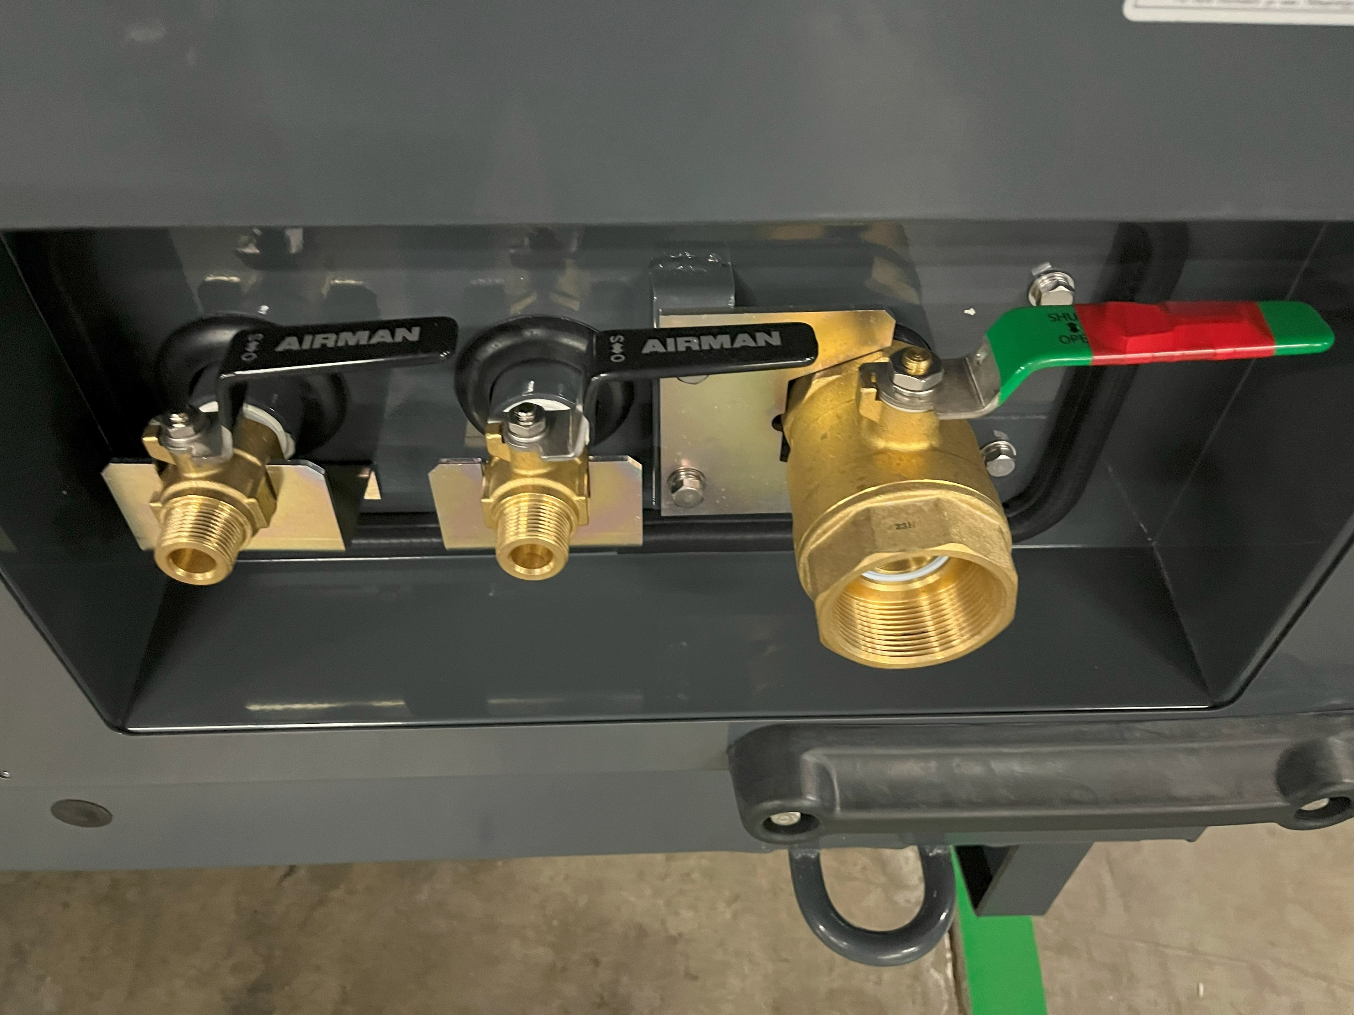
PDS185 Initial Key
Manual Compartment with Key sets
Inside Unit
Compressors
Key locations
On our compressors the red tape location is always on the service valves. There will be examples for different size compressors. The manual compartment will be inside the curbside door, next to the fuel cap.
PDS375/400 Initial Key

Slide 7
ENTER TEXT HERE
THANK YOU VERY MUCH!
(562) 450-3570 • ANACORP.COM • sales@anacorp.com

